Slide 1


Dishcover
An Interactive Mobile Cookbook
Jesper Riemer Andersen
Sam Sepstrup Olesen
Simon Reedtz Olesen
Jacob Karstensten Wortmann
Nicklas Andersen
Notes:
In this semester, the topic have been “Mobile systems” where we had to create a mobile application or service.
We will now present the result of our project, which is a mobile cookbook we call “Dishcover”.

Slide 2
Agenda
Analysis
Design
Login
Model Component
Search Algorithm
Test
Conclusion
Demonstration
2 OF 39 | 12.06.2014
Department of computer science
AALBORG UNIVERSITy
Notes:
This is the agenda for our presentation.
My name is Sam, and I will start talking about the motivation for the project and our analysis of some existing solutions.
Nicklas will then talk about the architecture of our system and the development of the user interface.
Then Simon will show an example of the client-server interaction and present our data structure.
Jesper will then describe our search algorithm and how we tested our system.
Finally, Jacob will talk about the conclusion of the project and show you a demonstration of our system.

Slide 3
Analysis
Sam Sepstrup Olesen

Slide 4
Analysis
design
login
Model
Search
test
conclusion
demonstration
Motivation
A digital cookbook might provide more functionality
Search
Filtering
Suggestions
Other solutions does not satisfy our needs
4 OF 39 | 12.06.2014
Department of computer science
AALBORG UNIVERSITy
Notes:
We have all had previous expirences with digital cookbooks.
The major advantages of digital cookbooks compared to traditional books is that they allow the content creators to update the cookbook with new recipes after release. Digital cookbooks also make it possible to have advanced searches like filtering out food containing meat if you are a vegetarian. Digital cookbooks might even learn what kind of food you prefer and give you suggestions for recipes you might like.
Allthough, we find that the content in digital cookbooks is often quite good, we have noticed that it can be hard to find good recipes if you don’t know exactly what you are looking for.
Fx, you might have some idea about what the recipe should contain. You could have some chicken beasts in your fridge that you need to use or see some food on sale in the supermarket, but you don’t know which recipes actually use those inngredients.
We then started to analyse some of the more sofisticat existing solutions...

Slide 5
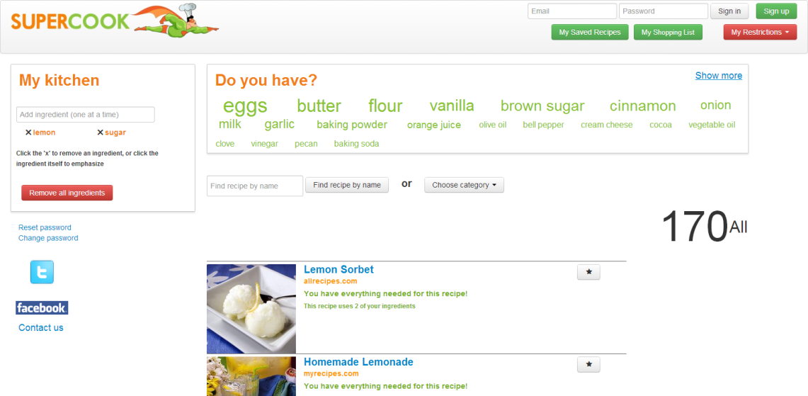
Analysis
design
login
Model
Search
test
conclusion
demonstration
Supercook
Web application
PROS
Word cloud
Search recipes by ingredients
CONS
ordering of recipes
5 OF 39 | 12.06.2014
Department of computer science
AALBORG UNIVERSITy
Notes:
One of those solutions is a web application called ”Supercook” which have a special kind of search.
We will now do a short demonstration of ”Supercook” to show some of its advantages and disadvantages.

Slide 6
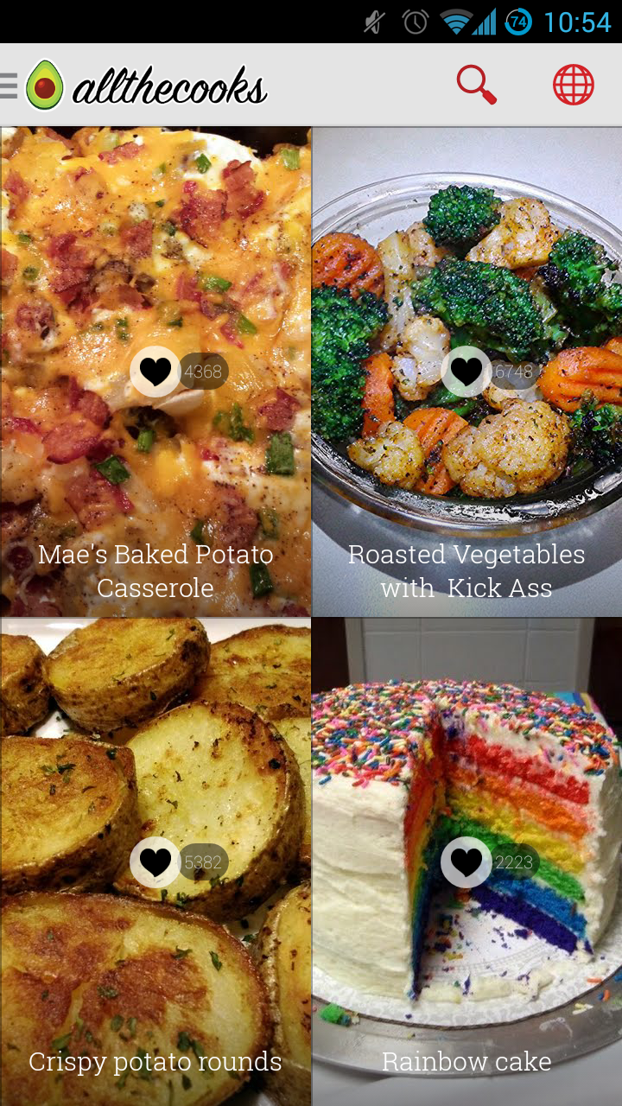
Analysis
design
login
Model
Search
test
conclusion
demonstration
Allthecooks
Android application
Pros
Beautiful design
Filtering search results
Favourite and shopping list
Cons
Have not implemented
search by ingredients
6 OF 39 | 12.06.2014
Department of computer science
AALBORG UNIVERSITy
Notes:
We also looked at some Android applications, one of them being ”allthecooks”, which is the most popular recipe-application for android.
It has a nice design which conforms to the Android guidelines defined by Google. That basically means that the application is easy to navigate.
It features regular text search where you are able to filter the result based on some ingredient requirements like ”no nuts”.
You are also able to save a recipe for later by adding it to your favourites. Likewise, you are able to add the individual ingredients of the recipes to a shopping list if you need to buy some of them.
Unlike ”Supercook”, it does not allow you to find recipes based on ingredients.

Slide 7
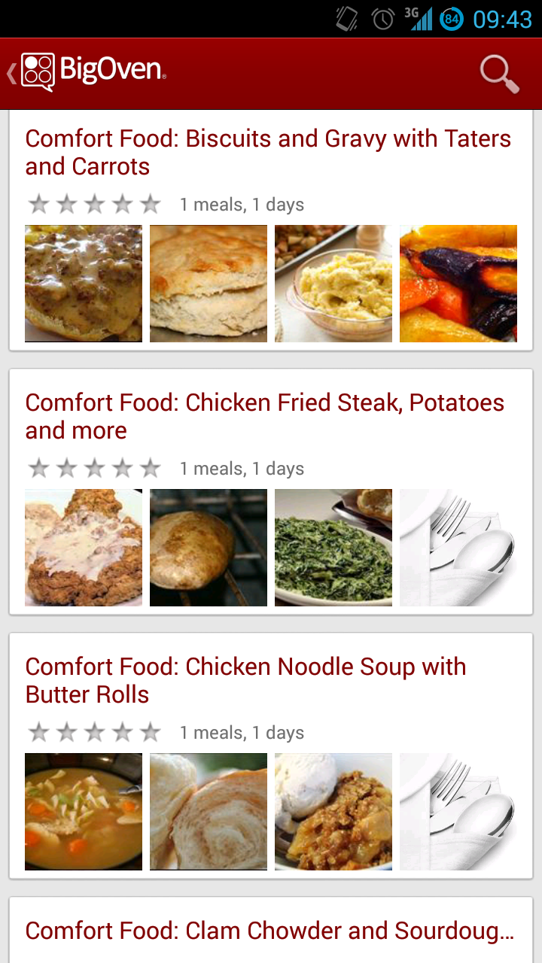
Analysis
design
login
Model
Search
test
conclusion
demonstration
BigOven
Android application
Pros
Menu-cards
Simple search by ingredients
Favourite and shopping list
Cons
Design and structure is cluttered
Hard to find the wanted functionality
7 OF 39 | 12.06.2014
Department of computer science
AALBORG UNIVERSITy
Notes:
Another Android application we looked at is called ”BigOven”.
It has some unique features like combining multiple recipes into ”menu-cards”.
It also has a primitive way to find recipes based on ingredients. You are limited to enter up to 3 ingredients, which then all have to be present in each recipe in the result. You can’t just enter what you have in your fridge.
Like ”allthecooks” you have a list favourite recipes and a shopping list.
It does not conform to the guidelines which makes it hard to navigate and find what you need in the application.

Slide 8
Analysis
design
login
Model
Search
test
conclusion
demonstration
Problem Statement
“How can we take advantage of the mobile platform and provide the user with relevant recipes based on specific ingredients, and taking any user defined restrictions, like allergies, into consideration.”
8 OF 39 | 12.06.2014
Department of computer science
AALBORG UNIVERSITy
Notes:
After the analysis we created the following problem statement:

Slide 9
Analysis
design
login
Model
Search
test
conclusion
demonstration
Requirements
Android
Search by ingredients
Free-teXt search
Search filters
Favourite recipes
Shopping List
Sharing
Persistency
Unit Conversion
Additional Languages
No login required
9 OF 39 | 12.06.2014
Department of computer science
AALBORG UNIVERSITy
Notes:
Based on the existing solutions and the problem statement we then derived the following requirements:
We are all familiar with andriod.
Support unit conversion between metric and imperial.
Prepare the application for localization and thereby provide support for additional languages.
Basic functionallity should be available without having to login.

Slide 10
Design
Nicklas Andersen

Slide 11
analysis
design
login
Model
Search
test
conclusion
demonstration
Architecture
11 OF 39 | 12.06.2014
Department of computer science
AALBORG UNIVERSITy

Slide 12
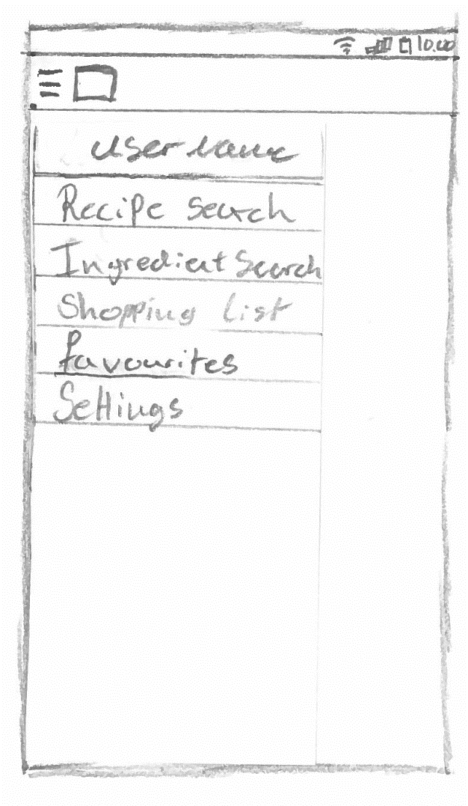
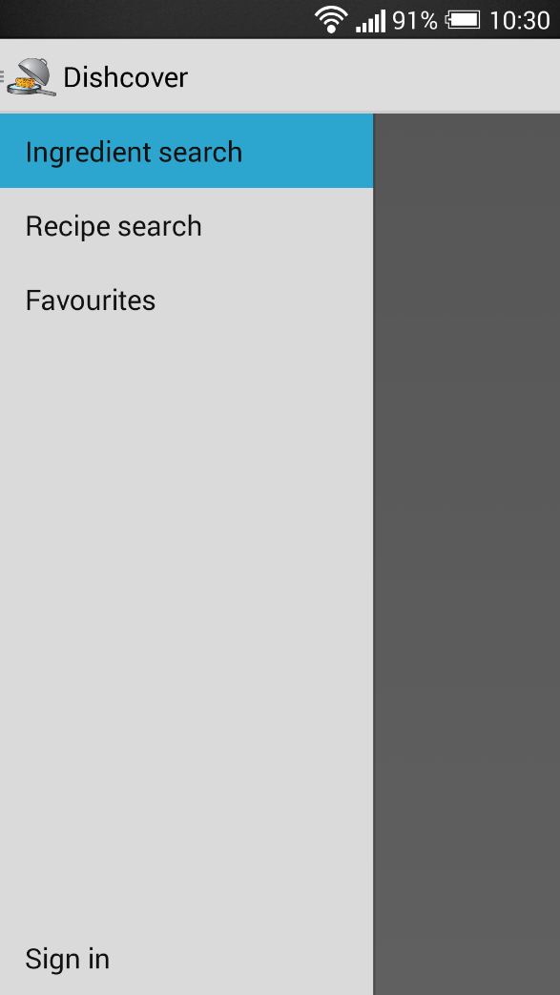
analysis
design
login
Model
Search
test
conclusion
demonstration
Navigation drawer
12 OF 39 | 12.06.2014
Department of computer science
AALBORG UNIVERSITy

Slide 13
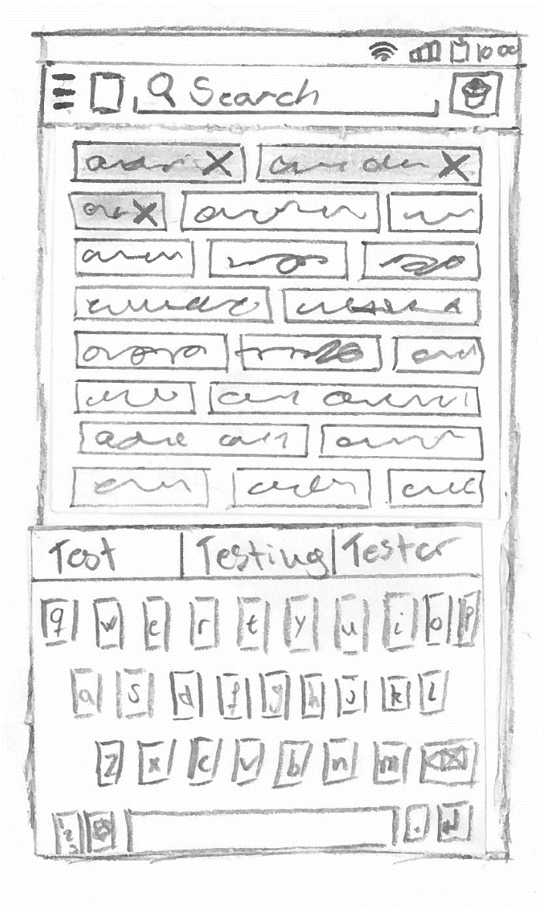
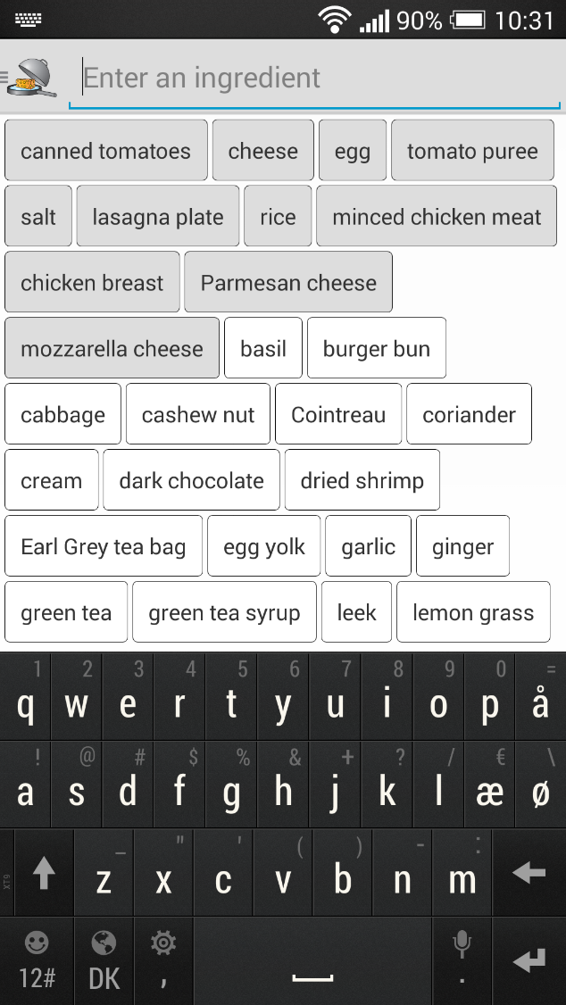
analysis
design
login
Model
Search
test
conclusion
demonstration
Search by ingredient
13 OF 39 | 12.06.2014
Department of computer science
AALBORG UNIVERSITy

Slide 14
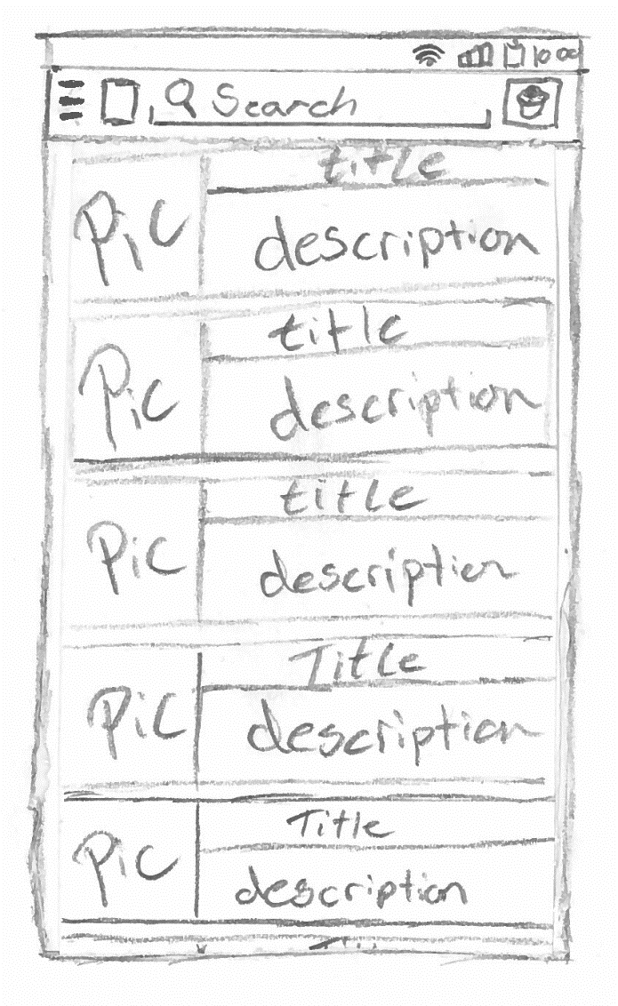
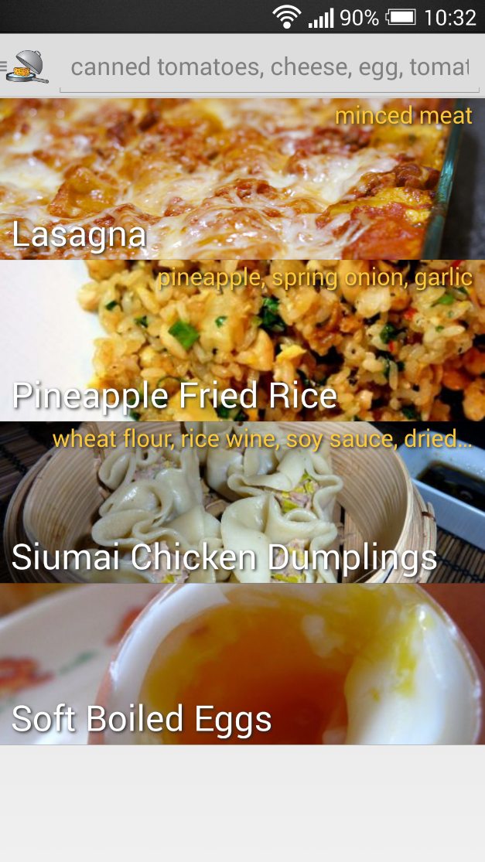
analysis
design
login
Model
Search
test
conclusion
demonstration
Result list
14 OF 39 | 12.06.2014
Department of computer science
AALBORG UNIVERSITy

Slide 15
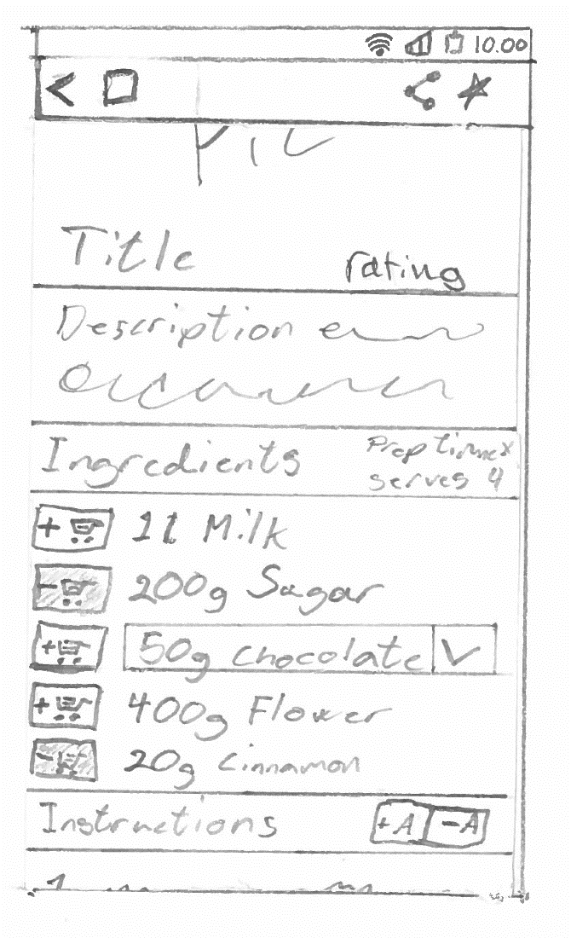
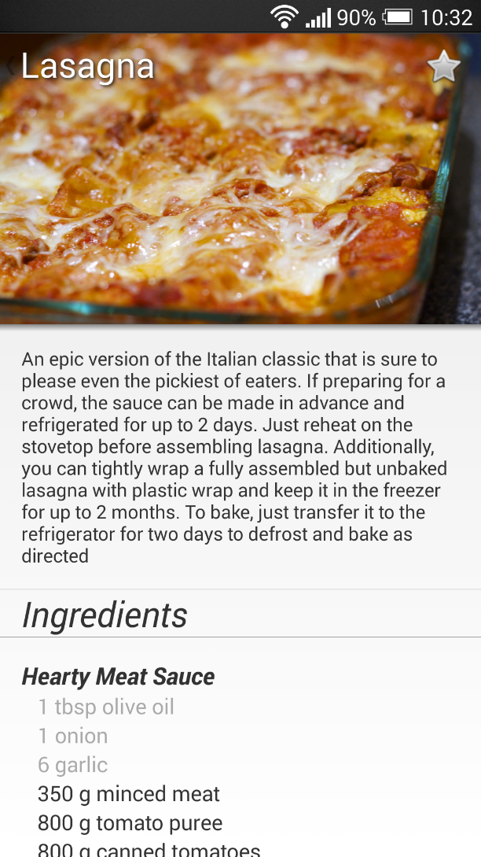
analysis
design
login
Model
Search
test
conclusion
demonstration
Recipe
15 OF 39 | 12.06.2014
Department of computer science
AALBORG UNIVERSITy

Slide 16

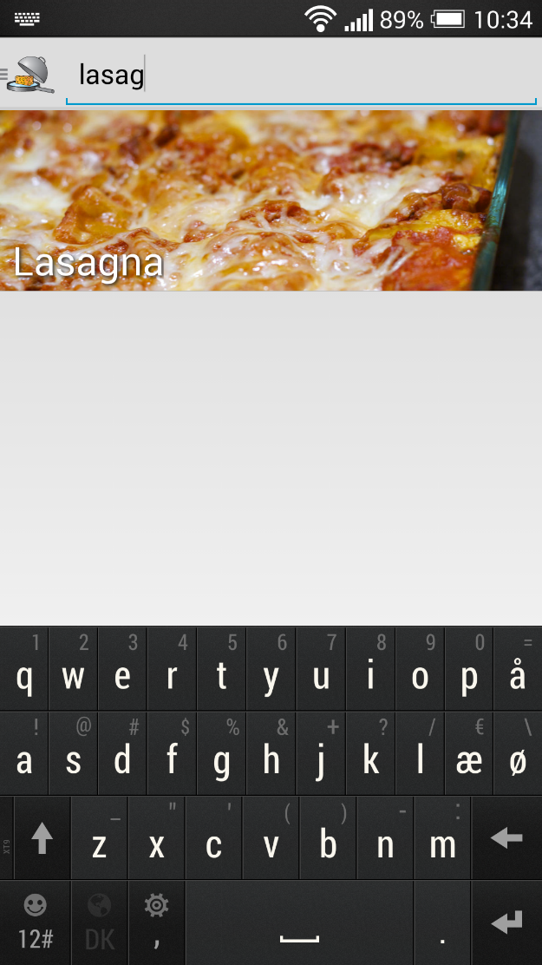
analysis
design
login
Model
Search
test
conclusion
demonstration
Text search
16 OF 39 | 12.06.2014
Department of computer science
AALBORG UNIVERSITy

Slide 17
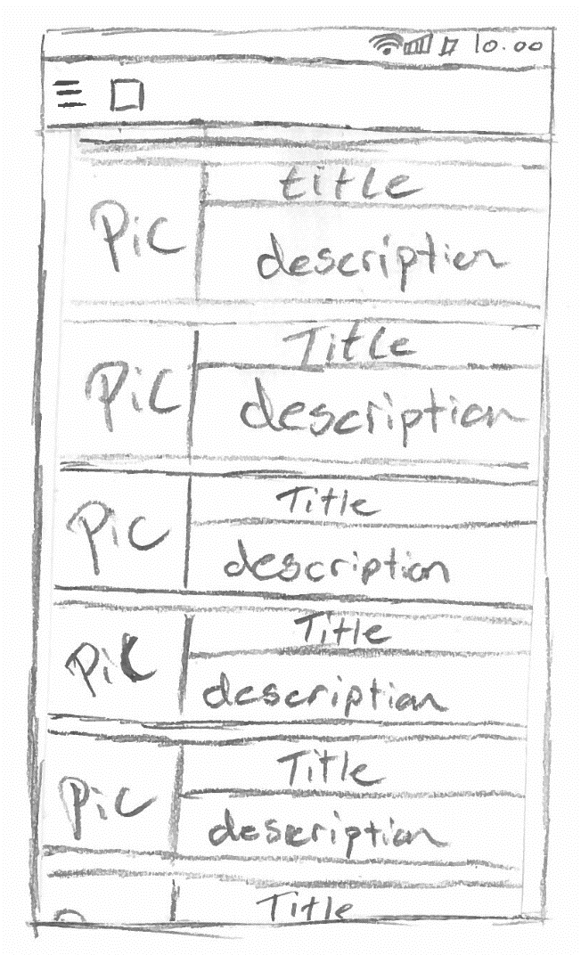
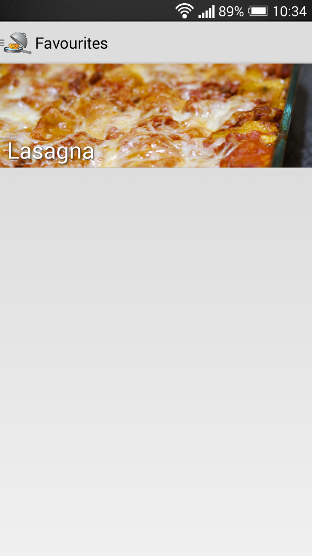
analysis
design
login
Model
Search
test
conclusion
demonstration
Favourites
17 OF 39 | 12.06.2014
Department of computer science
AALBORG UNIVERSITy

Slide 18
Login
Simon Reedtz Olesen

Slide 19
analysis
design
login
Model
Search
test
conclusion
demonstration
Social Media
Social media sign-ins
We use Google+
We use sign-in to identify the user
Remove the security measures
19 OF 39 | 12.06.2014
Department of computer science
AALBORG UNIVERSITy

Slide 20
analysis
design
login
Model
Search
test
conclusion
demonstration
Server Api
To get a user’s list of favourites we use the following URI:
http://figz.dk/food/lib/favourites.php? action=get& hash=d74df7a0c28526d5c811465046e455f33c0b3db5989c533c5b4576e2900e36c4&
limit=10&
offset=0&
lang=us
Hash is the user’s email hashed.
20 OF 39 | 12.06.2014
Department of computer science
AALBORG UNIVERSITy

Slide 21
analysis
design
login
Model
Search
test
conclusion
demonstration
Server Api
The server receives the client call
Action is “Get”
The method getFavourites($userHash, $limit, $offset, $lang) is called
Finds/creates the user(hash) in the database
Finds the user’s list of favourites
Returns the result
21 OF 39 | 12.06.2014
Department of computer science
AALBORG UNIVERSITy

Slide 22
analysis
design
login
Model
Search
test
conclusion
demonstration
Server Api
JSON format
[
{
"id": 7,
"name": "Lasagna",
"image": "e7ab82c4cf1c9c2823f74a4e664dd9fa.jpg"
},
{
"id": 30,
"name": "Habanero Pork Tenderloin",
"image": "18d1f7d26f781e1bee24d1dddc8772cd.jpg"
}
]
21 OF 40 | 12.06.2014
Department of computer science
AALBORG UNIVERSITy

Slide 23
Model Component
Simon Reedtz Olesen

Slide 24
analysis
design
login
model
Search
test
conclusion
demonstration
Model Component
the model resembles the relational database
23 OF 39 | 12.06.2014
Department of computer science
AALBORG UNIVERSITy

Slide 25
Entity-Relationship Diagram
24 OF 39 | 12.06.2014
Department of computer science
AALBORG UNIVERSITy

Slide 26
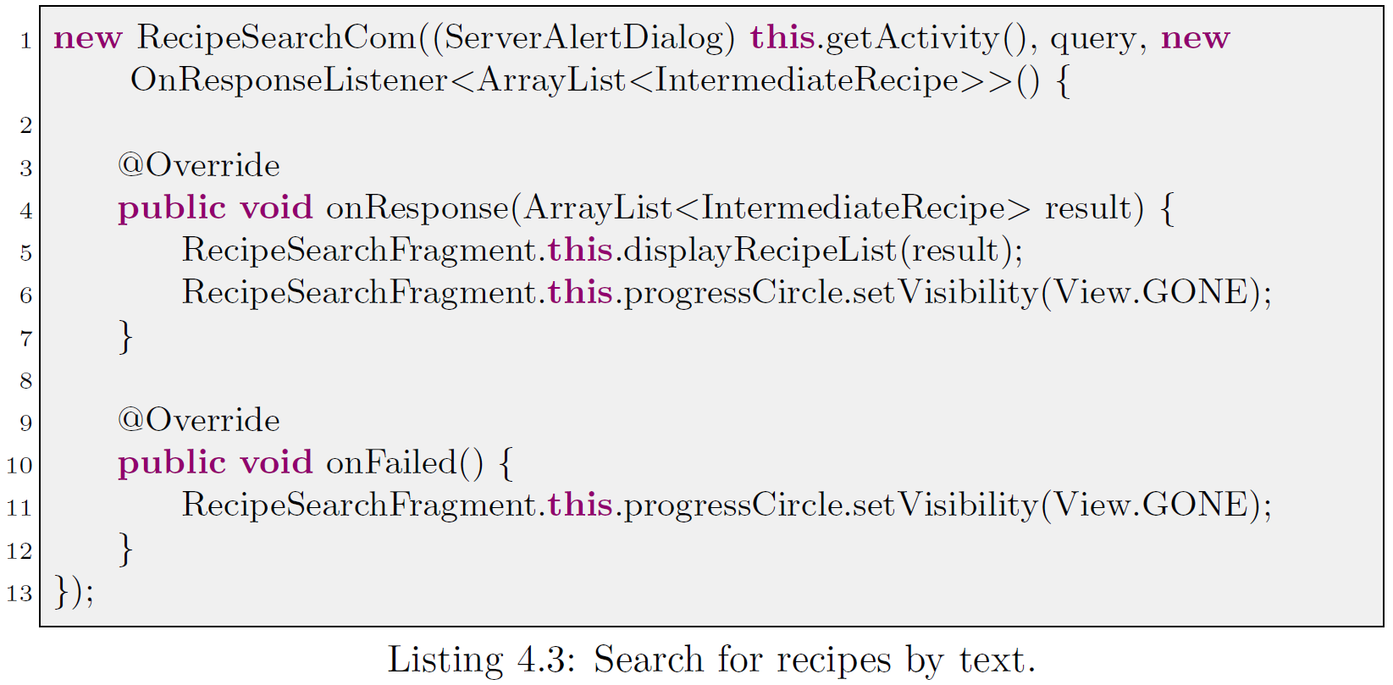
analysis
design
login
model
Search
test
conclusion
demonstration
Server Communication
ServerComTask
Asynchronous
25 OF 39 | 12.06.2014
Department of computer science
AALBORG UNIVERSITy

Slide 27
Search Algorithm
Jesper Riemer Andersen

Slide 28
analysis
design
login
model
search
test
conclusion
demonstration
Search by ingredients
Precedence function
Remove recipes without any matching ingredients.
Sort by least missing optional ingredients.
Sort by most matching optional ingredients.
Sort by least missing mandatory ingredients.
Sort by most matching mandatory ingredients.
27 OF 39 | 12.06.2014
Department of computer science
AALBORG UNIVERSITy
Notes:
The primary feature of the application is the ability to search for recipes by ingredients.
Supercook also has the feature, but unlike them we want the recipes with the most matching ingredients to have the highest precedence.
We think this makes more sense, because the user will most likely not, or never, type in all the ingredients of a recipes.
The last sort will have higher precedence than earlier sorts.
This sort means that
We will get recipes that have as many matching ingredients as possible.
If the same amount, the recipes where we need fewest mandatory ingredients.
If the same amount, then we do the same for optional ingredients.

Slide 29
analysis
design
login
model
search
test
conclusion
demonstration
Matching ingredients
Calculate how many of the user specified ingredients exists in each recipe.
Find all quantities that contains an ingredient specified by the user. $quantityQuery
Check Whether each quantity appear as a part of a mandatory and/or an optional exchangeable. $ingredientQuery
Count the number of distinct matching mandatory and optional ingredients for each recipe. $matchingQuery
28 OF 39 | 12.06.2014
Department of computer science
AALBORG UNIVERSITy
Notes:
First we calculate the matching ingredients for each recipe.
This is all executed as one big query, but with these nested queries.

Slide 30
analysis
design
login
model
search
test
conclusion
demonstration
Missing ingredients
Calculate how many not covered exchangeables exists in each recipe.
$lackingQuery
Find all exchangeables that does not contain an ingredient specified by the user or an ignored ingredient.
Count the number of mandatory and optional exhangeables for each recipe.
29 OF 39 | 12.06.2014
Department of computer science
AALBORG UNIVERSITy
Notes:
Then we calculate the missing ingredients for each recipe.
We retrieve all the exchangeables that does not contain an ingredient specified by the user.
Remember exchangeables consists of several ingredients.
Then count the number

Slide 31
analysis
design
login
model
search
test
conclusion
demonstration
Sort result
Order the result according to the precedence function.
$sortingQuery
Recipe | Mandatory matching | Mandatory missing | Optional matching | Optional missing
Boiled egg | 1 | 0 | 0 | 0
Cookies | 4 | 1 | 0 | 3
Ice cream | 2 | 3 | 1 | 1
Bread | 4 | 3 | 1 | 2
Recipe | Mandatory matching | Mandatory missing | Optional matching | Optional missing
Cookies | 4 | 1 | 0 | 3
Bread | 4 | 3 | 1 | 2
Ice cream | 2 | 3 | 1 | 1
Boiled egg | 1 | 0 | 0 | 0
30 OF 39 | 12.06.2014
Department of computer science
AALBORG UNIVERSITy
Notes:
Then we sort the recipes with the precedence function shown before.
Mandatory matching
Mandatory missing
Optional matching
Optional missing
Supercook's sorts by the number of missing ingredients, which means boiled egg would be at the top.

Slide 32
Test
Jesper Riemer Andersen

Slide 33
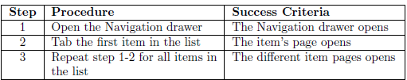
analysis
design
login
model
search
test
conclusion
demonstration
Black-Box
Test Cases
Procedures
Success Criteria
Case Results
Shopping List not implemented
32 OF 39 | 12.06.2014
Department of computer science
AALBORG UNIVERSITy
Notes:
Testcases:
Our testcases consist of steps which each have a procedure and a succes criteria
If all the steps in the test case succeds, the testcase has been is successful.
Case Results:
Unfortunately could not test the shopping list since it was not implemented.
All of our black testcases was successful except the testcases where the feature had not yet been implemented.

Slide 34
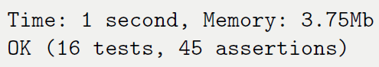
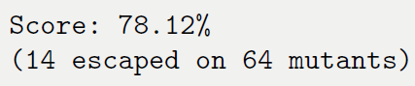
analysis
design
login
model
search
test
conclusion
demonstration
White-Box
Database copy
Unit Test
Server
Code Coverage
Mutation Testing
Code Coverage vs. Mutation
33 OF 39 | 12.06.2014
Department of computer science
AALBORG UNIVERSITy
Notes:
Unittest:
We designed the client to be as thin as possible, meaning that mostly all processing is done on the server.
Because of this we have chosen to focus on testing the server, because if we are confident that the server always
returns the correct result, then we only make sure that the client the sends the correct message.
We succeded in having 100% code coverage on the server, which makes us more confident that the server returns
the correct answer to client.
Mutation testing:
To ensure that our tests works as intended we perform a mutation test, the mutation test will alter the code and if our unit test passes it is considered defective, and should be refactored. We have 14 unit test that is considered defective of 64 mutants. Which mean that our mutation test score is 78% of our unit test is good. With more time we could improve our mutation test score.

Slide 35
Conclusion
Jacob Karstensen Wortmann

Slide 36
analysis
design
login
model
search
test
conclusion
demonstration
Conclusion
The application provides relevant recipes based on ingredients
Powered by a search algorithm
Easy to navigate
Support for free-text search
User can login using Google+
Confident that the server returns correct results
35 OF 39 | 12.06.2014
Department of computer science
AALBORG UNIVERSITy
Notes:
Relevant recipes & Powered by a search algorithm:
We are confident that our application can provide the user with relevant recipes, based on the ingredients that they have given as input, This is possible since our application is powered by our search algortim as Jesper told you about earlier.
Easy to navigate:
With implementation of the navigation drawer we have made the application suitable for Android users.
Most Android user are familiar with the navigation drawer from other applications, and therefore they do not need to learn a design.
Support for free-text search:
The application also supports the standard free-text search, which basically matches the input of the user with the recipe's title and description.
User can login using Google+:
The user can also use the social media Google+ to sign-in in to the application. This gives ud the ability to identify the user and save user related information, such as their list of favourite recipes.
Confident that the server returns correct results:
based on our test and mutation test we can with confidence say that our server returns the correct message back to the client.

Slide 37
Future Work
Jacob Karstensen Wortmann

Slide 38
analysis
design
login
model
search
test
conclusion
demonstration
Future work
Shopping list
Start page
Recipe filters
Sharing
Recipe cache
Recipe license
Conversion
Recipe references
Settings
Scaling of recipes
Intelligent sort of ingredients
User created recipes
Localisation
Log interesting ingredient searches
Revoke Google account access
37 OF 39 | 15.02.2014
Department of computer science
AALBORG UNIVERSITy

Slide 39
Demonstration
Jacob Karstensen Wortmann

Slide 40
Bon Appétit

